Slide 1




ECSim: Energy Conserving Semi Implicit Particle in Cell Method
G. Lapenta
E. Boella
A. Micera
EMC2
J. Park
18th European Fusion Theory Conference
Gent, Belgium, 7-10 October 2019
Notes:
30 minute on Wednesday from 10:00 AM–10:30 AM

Slide 2
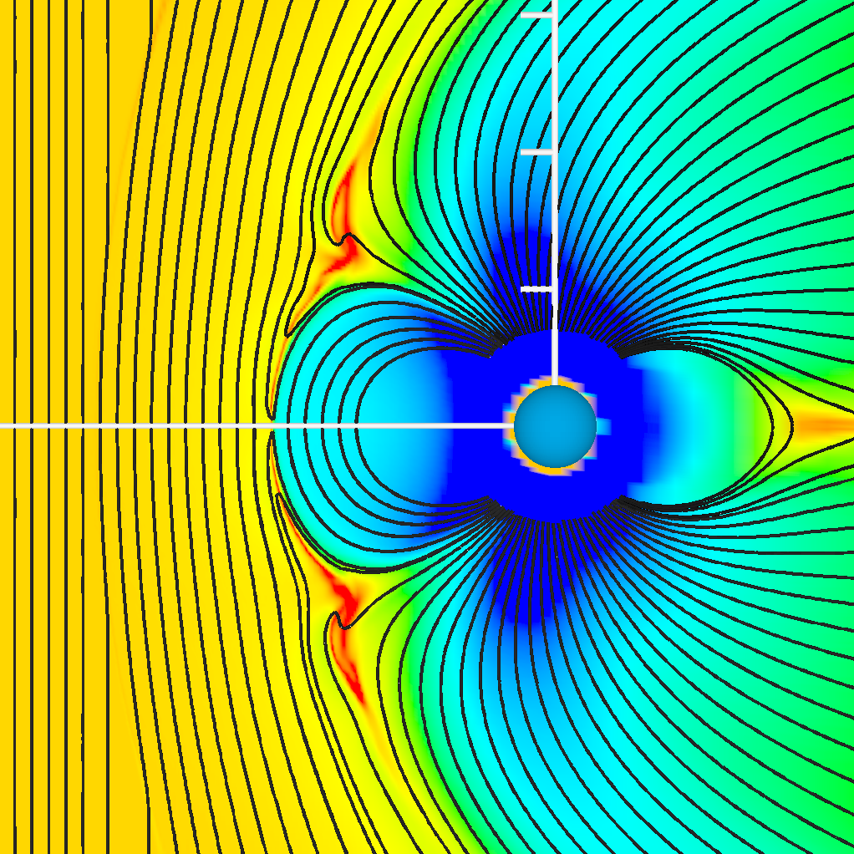
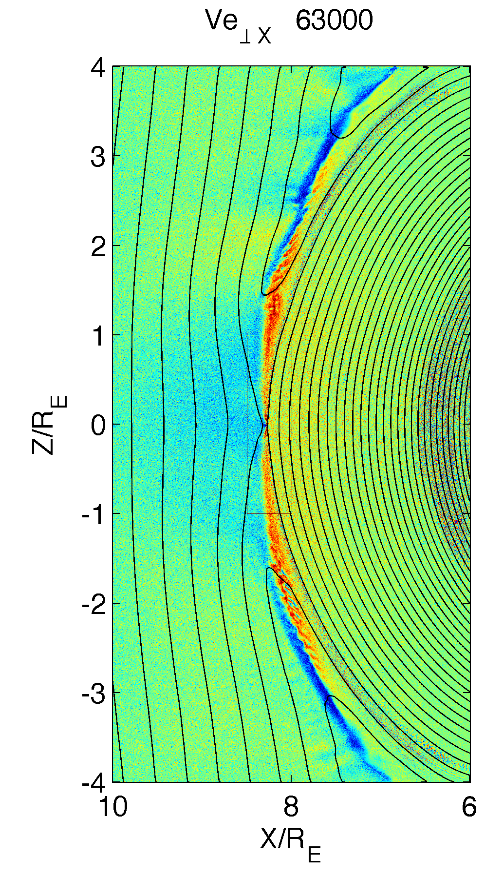
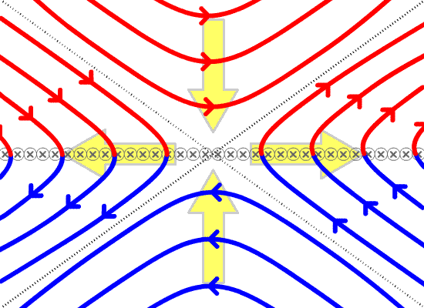
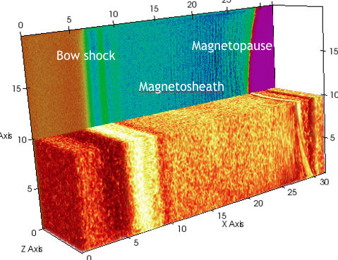
Need for coupling micro-macro scales to study reconnection
MHD

Slide 3
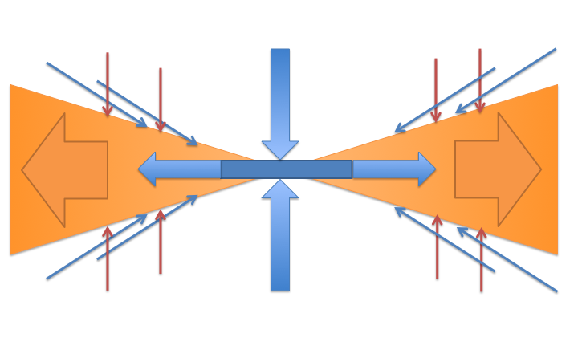
Need to go beyond MHD and to couple multiple scales
Sweet-Parker
Kinetic Reconnection
Petschek

Slide 4
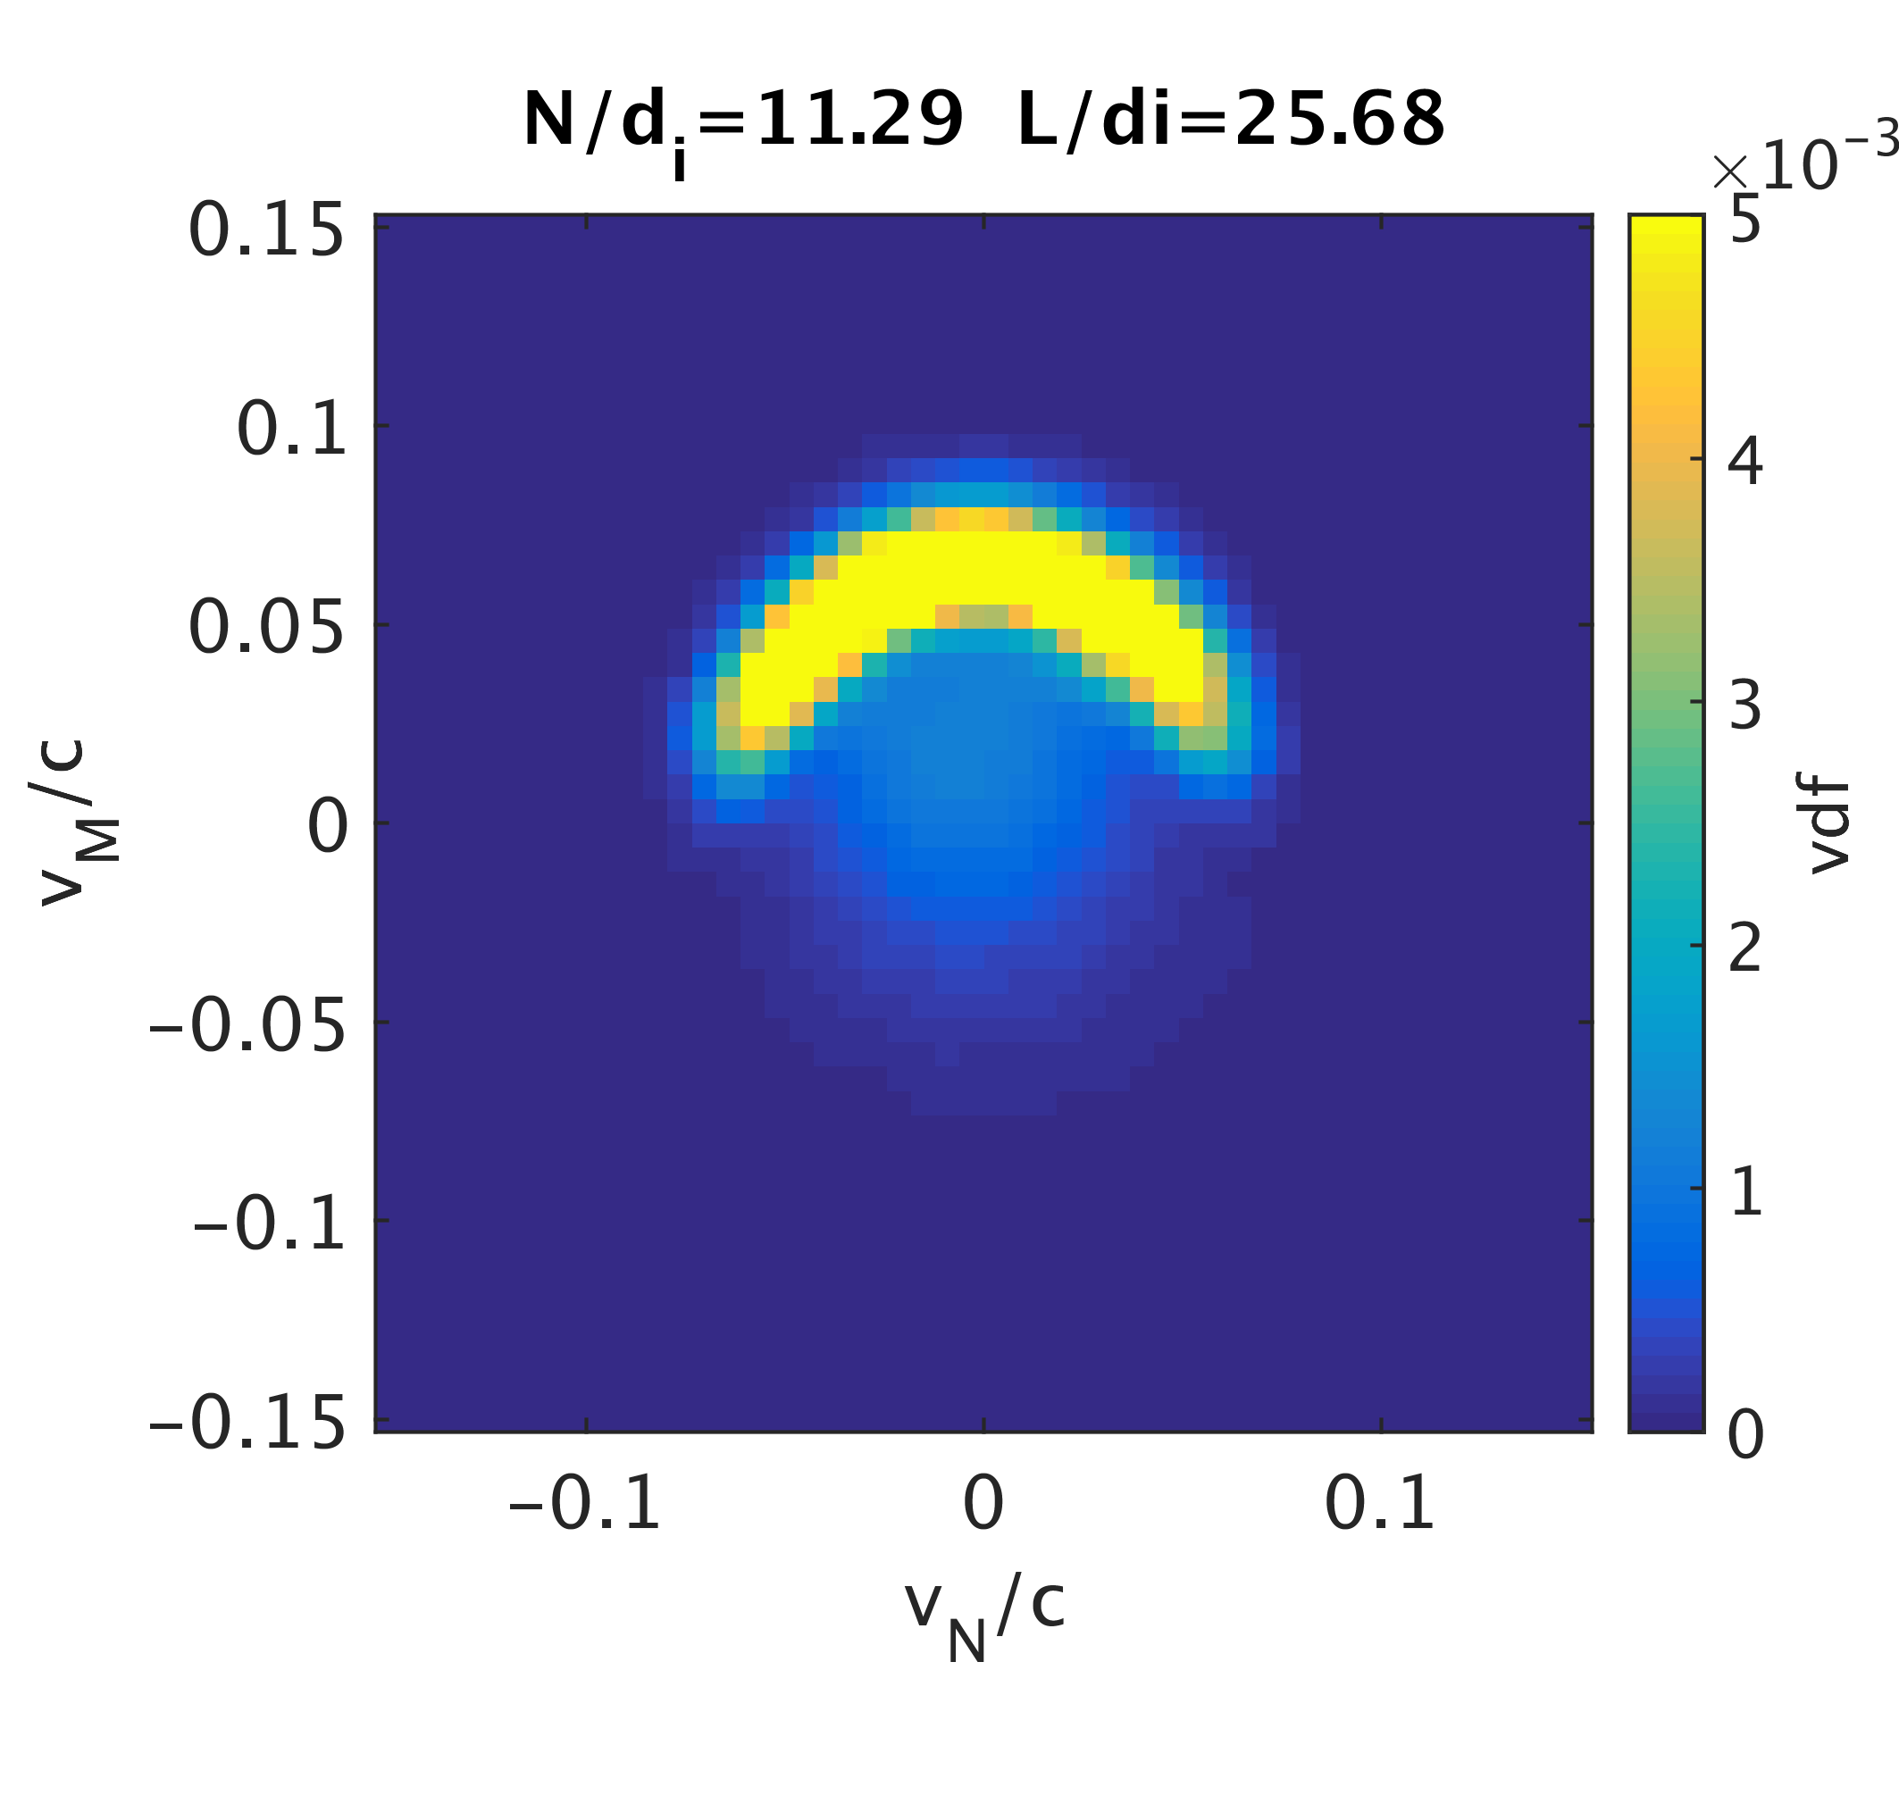
Electron complex physics
MMS
Burch et al, Science, 2016
MMS mission
iPic3D simulation
ECSim simulation of the Earth dayside
Lapenta et al, JGR, 2017.

Slide 5
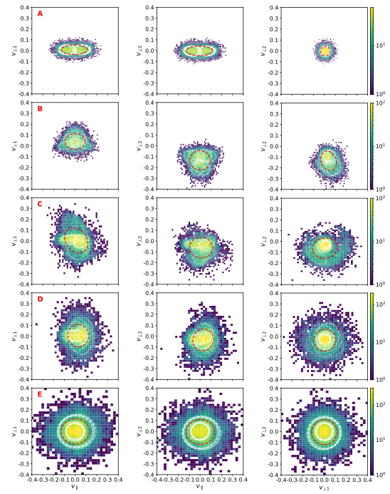
Complexity of the electron distribution: A machine learning approach
Bayesian Gaussian mixture
Agyrotropy
Dupuis, Amaya, Lapenta, ApJ, submitted

Slide 6
Role of electrons in turbulent cascade
Phan et al., Nature, 2018

Slide 7
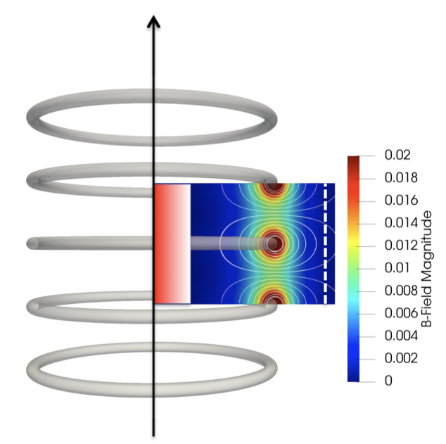
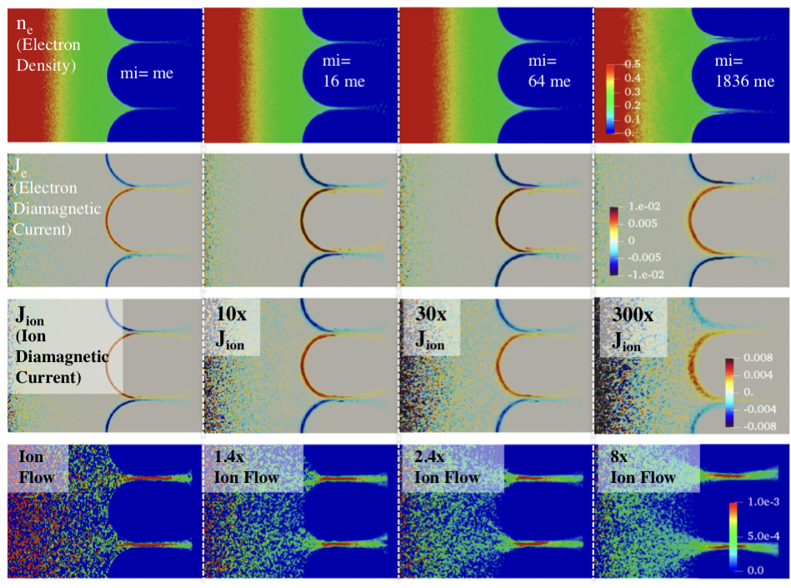
Diamagnetism in high beta fusion devices
Park, J., Lapenta, G., Gonzalez-Herrero, D., & Krall, N. (2019). Discovery of an Electron Gyroradius Scale Current Layer Its Relevance to Magnetic Fusion Energy, Earth Magnetosphere and Sunspots. arXiv preprint arXiv:1901.08041.

Slide 8
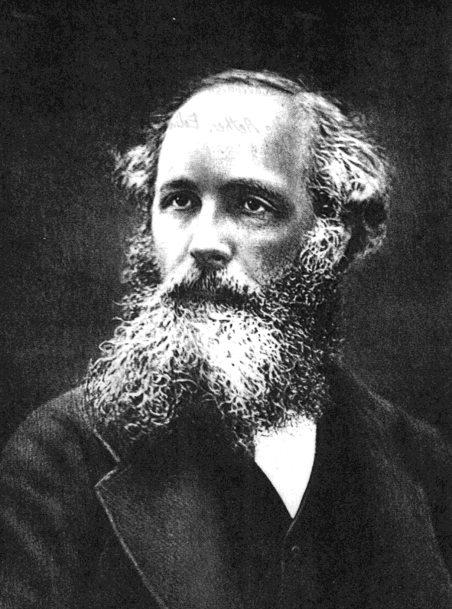
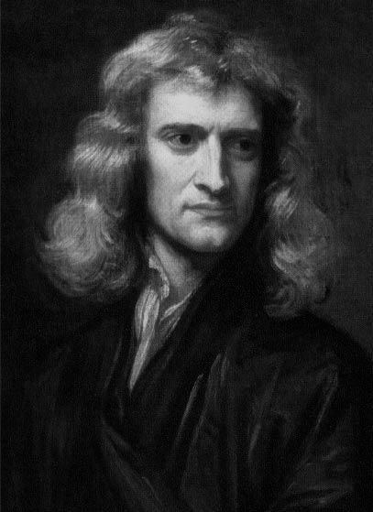
Full Kinetic model: particle in cell
coupling
E,B
ρ,J
Maxwell
Newton

Slide 9
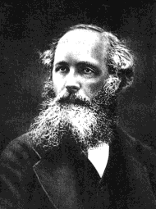
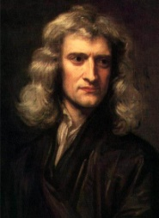
Explicit Computational approach
T=0
T=Δt
T=2Δt
Operations:
Solve Newton equations in previous electromagnetic fields
Solve Maxwell equations with previous particle positions

Slide 10
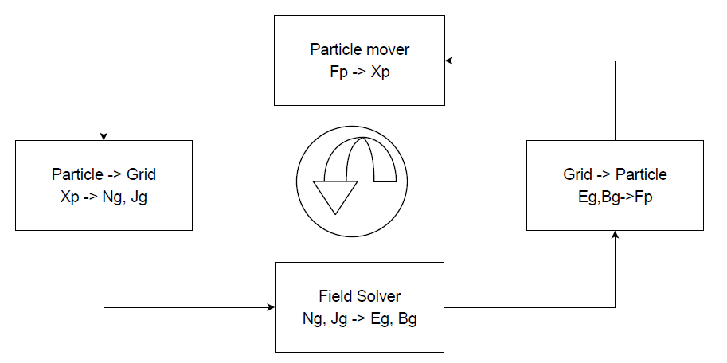
Limits of the Explicit method
Explicit mover : ω_{pe} Δt < 2
Explicit
Particle- Grid coupling: Δx < 3 λ_{De}
Explicit Maxwell solver: c Δt < Δx

Slide 11
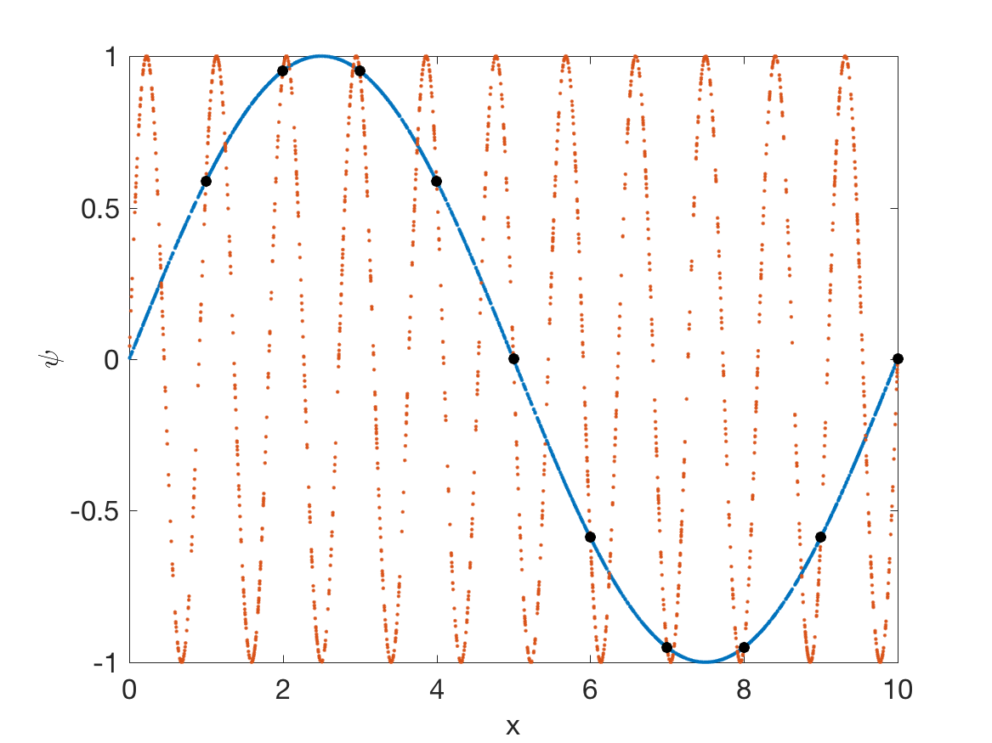
Aliasing: finite grid instability
Explicit Particle- Grid coupling: Δx < 3 λ_{De}

Slide 12
The challenge in modeling space plasmas: multiple scales
Explicit methods need to resolve all temporal and spatial scales:
  Explicit Maxwell solver: c Δt < Δx
  Explicit mover : ω_{pe} Δt < 2
  Explicit Particle- Grid coupling: Δx < ξλ_{De}
Solar wind at 1AU
millions km
MACRO
(fluid)
hours
System scales
L=10000 km
1 m
MICRO
(kinetic)
ρ_{i} d_{i}=80 km
Ω_{i} = 0.09Hz
ion scales
ω_{i} = 0.55kHz
ρ_{e} d_{e}=2 km
Ω_{e} = 0.16kHz
electron scales
λ_{e}=8 m
ω_{e} = 24kHz

Slide 13

Explicit and implicit Computational approaches
T=0
T=Δt
T=2Δt
EXPLICIT
Hockney, R. W., & Eastwood, J. W. (1988). Computer simulation using particles. CRC Press.
Operations:
Solve Newton equations in previous electromagnetic fields
Solve Maxwell equations with previous particle positions
IMPLICIT
T=0
T=Δt
Markidis, S., and G. Lapenta. (2011) JCP 230.18 7037.
Chen, G., Chacón, L., & Barnes, D. C. (2011). JCP, 230.18, 7018.
Operations:
Over each time step, iteratively solve the two coupled equations until convergence

Slide 14
The challenge in modeling space plasmas: multiple scales
Explicit methods need to resolve all temporal and spatial scales:
  Explicit Maxwell solver: c Δt < Δx
  Explicit mover : ω_{pe} Δt < 2
  Explicit Particle- Grid coupling: Δx < ξλ_{De}
Implicit methods can resolve any range of scales
Solar wind at 1AU
millions km
MACRO
(fluid)
hours
System scales
L=10000 km
1 m
MICRO
(kinetic)
ρ_{i} d_{i}=80 km
Ω_{i} = 0.09Hz
ion scales
ω_{i} = 0.55kHz
ρ_{e} d_{e}=2 km
Ω_{e} = 0.16kHz
electron scales
λ_{e}=8 m
ω_{e} = 24kHz

Slide 15





Venus
Brackbill, Forslund, JCP, 1985
Celeste
Lapenta, Ricci, Brackbill, PoP, 2005
iPic
Markidis, Lapenta, MCS, 2010
ECSIM
Lapenta, JCP, 2017
New Directions
MLMD
Exascale/GPU
Parsek2D
Semi-Implicit Temporal Discretization for Multiscale PIC
Hybrid
computing
Stability - Energy
conservation
www.ecsimpic.org
Distributed
computing
www.ipic3d.org
Markidis, S., Camporeale, E., Burgess, D., & Lapenta, G. ASP Conference Series, (Vol. 406, p. 237), 2009.
Krylov
methods
Vector
computers

Slide 16
Full Kinetic model: implicit particle in cell
T=0
T=Δt
NL
fields
particles
Non-linear Newton- Krylov iteration

Slide 17
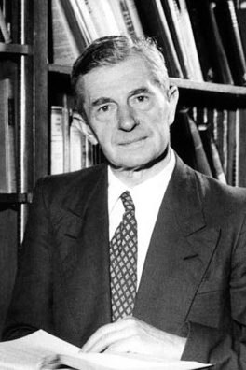
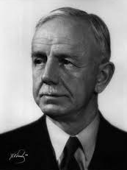
Full Kinetic model: implicit moment method
T=0
T=Δt
IMPLICIT
MOMENT
METHOD
fields
moments
particles
Brackbill, Forslund, JCP, 1985; Ricci, Lapenta, Brackbill, JCP, 2002; Lapenta, Ricci, Brackbill, PoP 2005

Slide 18
The challenge in modeling space plasmas: multiple scales
Implicit methods can resolve any range of scales
The Implicit moment method looses energy conservation and it has a narrower stability region
The resolution cannot exceed the electron scales too much (problem dependent)
Solar wind at 1AU
millions km
MACRO
(fluid)
hours
System scales
L=10000 km
1 m
MICRO
(kinetic)
ρ_{i} d_{i}=80 km
Ω_{i} = 0.09Hz
ion scales
ω_{i} = 0.55kHz
ρ_{e} d_{e}=2 km
Ω_{e} = 0.16kHz
electron scales
λ_{e}=8 m
ω_{e} = 24kHz

Slide 19

New Method: ECSim
Lapenta, JCP, 334 (2017); Lapenta, Gonzalez-Herrero, Boella, JPP, 83 (2017).
change mover
Current expressed exactly with the
mass matrix

Slide 20
Semi implicit energy conserving
Energy Conserving Semi-Implicit (ECsim) method
Formulate the plasma response using the mass matrix
Enforcing EXACT energy conservation
Stability comparable to fully implicit method
Mass Matrix Formulation
T=0
T=Δt
fields
mass matrix
particles
Lapenta, JCP, 334, 2017; Lapenta, Gonzalez-Herrero, Boella, JPP, 83.2, 2017.

Slide 21
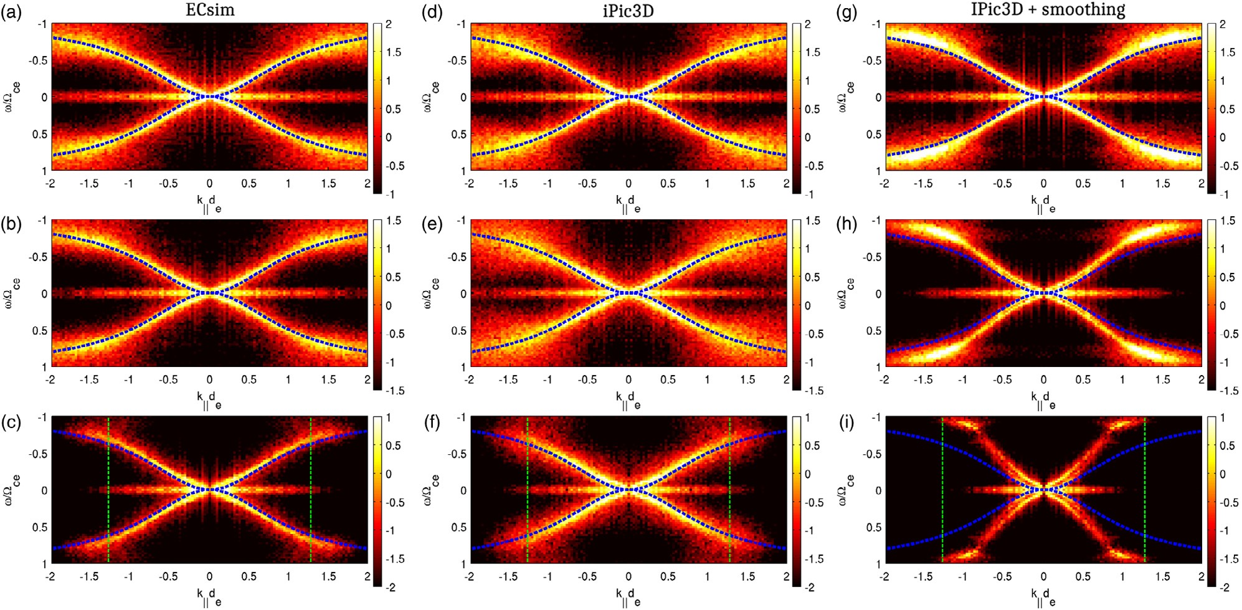



ECsim: increased stability removes the need for smoothing
$$Δx=0.04d_{i}$$
$$Δx=0.08d_{i}$$
$$Δx=0.16d_{i}$$

Slide 22
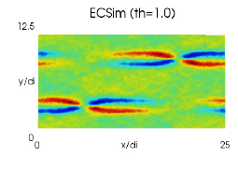
Example 2: Reconnection in the solar wind
Lapenta, JCP, 334 (2017); Lapenta, Gonzalez-Herrero, Boella, JPP, 83 (2017).
Energy Error
Energy converted
V_{the}/c= 0.001 (about 1eV)

Slide 23
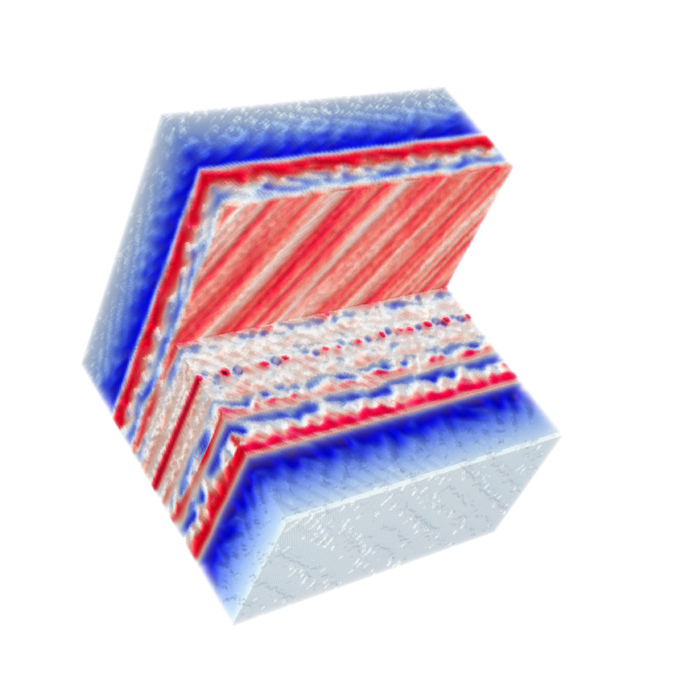
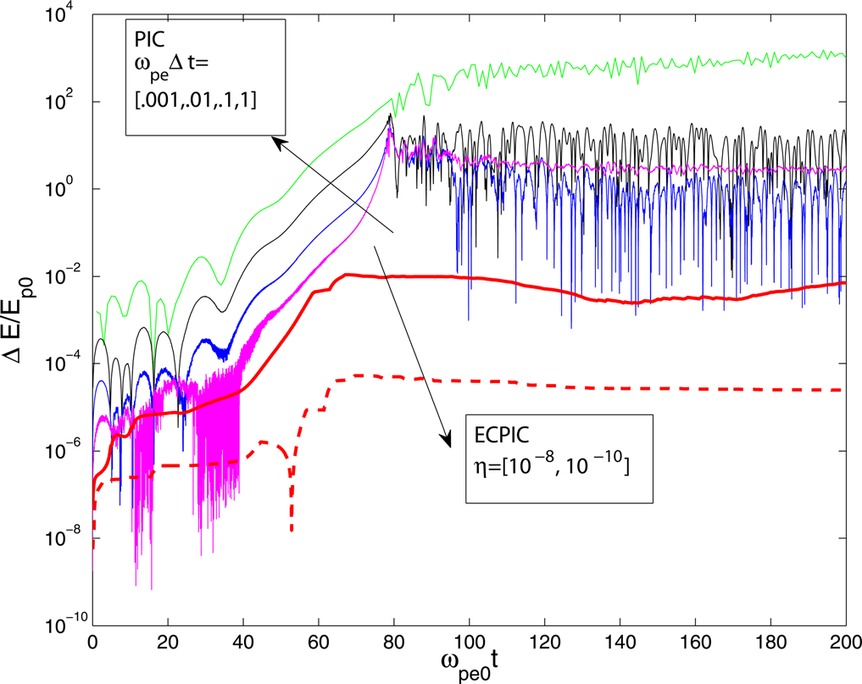
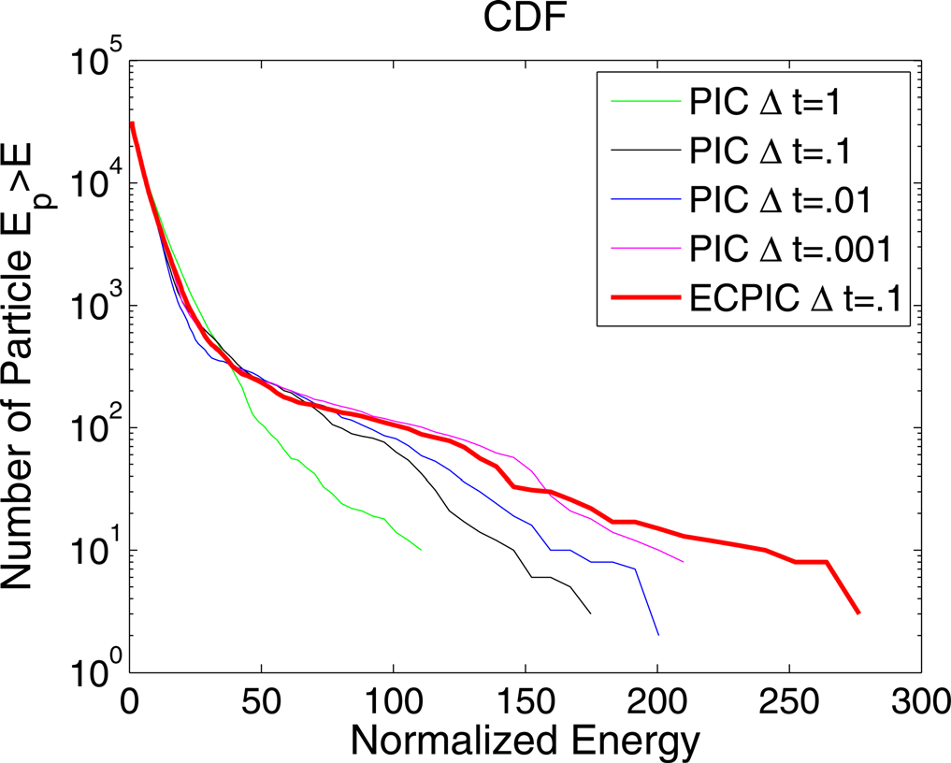
Applications of the ECsim approach

Slide 24
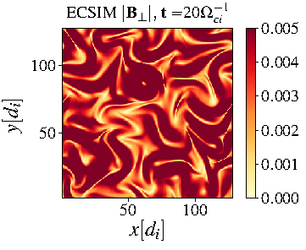
Plasma turbulence: full PIC versus hybrid
Pecora, F., Pucci, F., Lapenta, G., Burgess, D., & Servidio, S. (2019). Solar Physics, 294(9), 114.

Slide 25
ECsim-CYL: a 2D cylindrical geometry semi-implicit PIC: spherical free expansion of a plasma sphere
Gonzalez-Herrero, D., Micera, A., Boella, E., Park, J., & Lapenta, G. (2019). Computer Physics Communications, 236, 153-163.

Slide 26
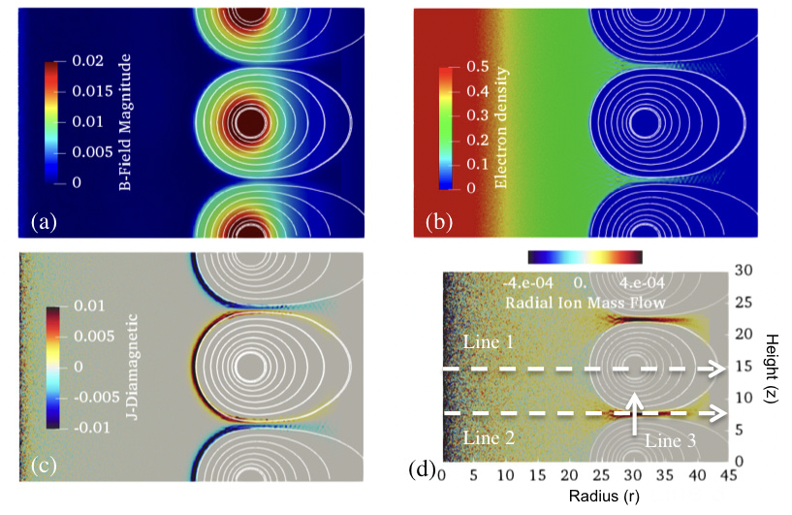
ECSim-CYL simulation of diamagnetism in a high beta fusion device
Park, J., Lapenta, G., Gonzalez-Herrero, D., & Krall, N. (2019). Discovery of an Electron Gyroradius Scale Current Layer Its Relevance to Magnetic Fusion Energy, Earth Magnetosphere and Sunspots. arXiv preprint arXiv:1901.08041.

Slide 27
Summary
Plasmas are challenging because of the separation between scales in space and time
The wide separation can be addressed with implicit particle in cell methods
Implicit methods can be:
  Semi-implicit (linear solvers): iPic3D, implicit moment method
  Fully implicit (non-linear Newton iteration)
A new method: Energy Conserving Semi Implicit (ECSim)
Example of the study of reconnection from photosphere to solar wind and magnetospheres
New Cylindrical implementation for 2D faster studies
Recent Developments:
Subcycling and gyroaveraging [Lapenta, submitted]
Energy Conserving Smoothing [Lapenta, submitted]
Quasi-neutral implementation [Lapenta et al., submitted]
Approximation of mass matrix for faster implementation [Lapenta et al., submitted]
Second order and charge conserving implementation [Chen and Toth, JCP, 2019]

