Slide 1
Moment-based multilevel preconditioning for an implicit, conservative, hybrid particle-kinetic-ion fluid-electron algorithm
European Fusion Theory Conference
Ghent, Belgium, Oct. 7-10, 2019
Luis Chacón
Collaborators: Adam Stanier, Guangye Chen
Work supported by US Dept. of Energy
Office of Applied Scientific Computing Research
LA-UR-19-20165
Notes:
20 seconds

Slide 2
Agenda
Motivation
Continuum model and its conservation properties
Discrete formulation
  Particle-in-cell (PIC) + collocated fields (PIXIE3D) + implicit timestepping
  Strict conservation properties
Nonlinear solution method
  XMHD-based preconditioning (PIXIE3D)
Verification and performance
Extension to curvilinear meshes
Asymptotic well-posedness of hybrid-PIC: a cancellation issue
Conclusions

Slide 3

Motivation for a hybrid kinetic-ion fluid-electron model
Electrons experience enhanced collisionality vs ions owing to smaller mass ( )
Many important phenomena are controlled critically by ion kinetic effects (ITG, reconnection, shocks), but not electron’s
  Although some fidelity is lost on ion scales on some phenomena (Told, NJP 2016)
Fully electromagnetic model
Is a complementary model to gyrokinetics for laboratory fusion plasmas, without asymptotic assumptions on the ion orbits
  Multi-scale implicit techniques allow modeling of weakly growing instabilities with full orbit hybrid model (Sturdevant et al., PoP 2017)
  AP full-orbit treatment possible (Ricketson, LC)
Can be used later as a core algorithm to include electron physics and couple with other physical models.
y/di
Fig. 2. Finite ion orbit effects give broader diffusion region supported by non-gyrotropic pressure tensor effects.
Fig. 1. Average reconnection rates vs. system size for island coalescence.

Slide 4
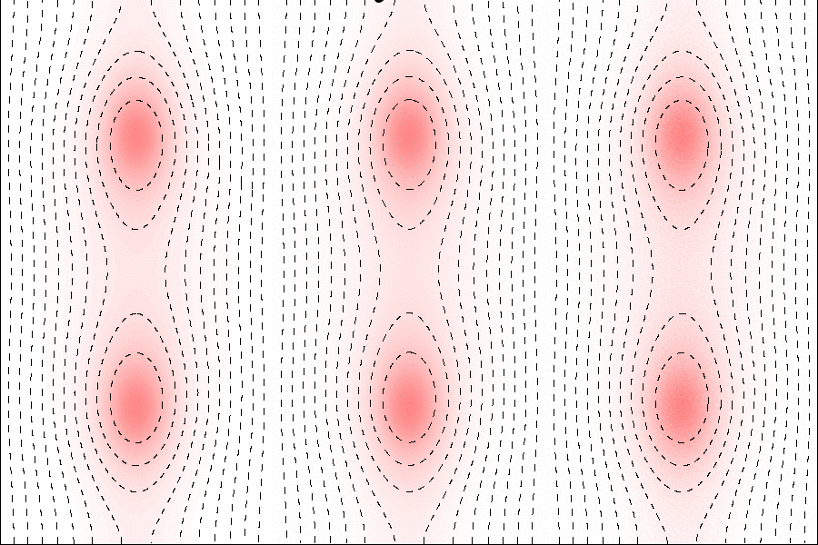
Application: Magnetic reconnection
Hall-MHD
Hybrid
Kinetic (PIC)
Averaged reconnection rates
4πλ
λ = 10di
    Hybrid model is minimum sufficient model to reproduce fully kinetic reconnection rates and MHD-to-ion scale coupling (Stanier et al., PRL 2015, Ng et al., PoP 2016).
    Key ion kinetic physics is missing from Hall-MHD fluid model.
Slide 4
Notes:
1 minute

Slide 5
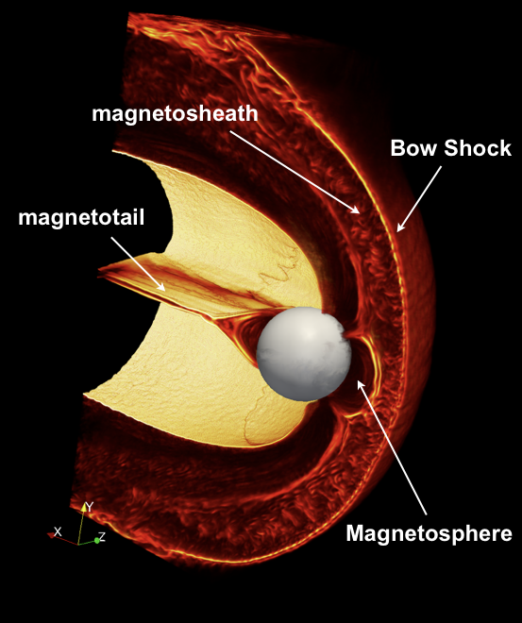
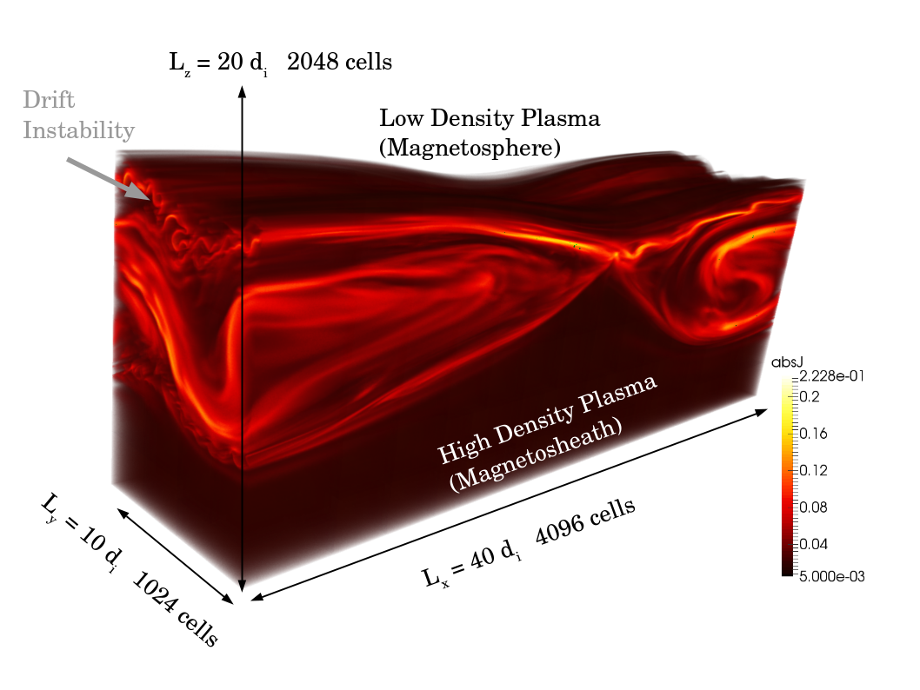
Application: System-scale magnetosphere simulations
Importance of kinetic ions in space plasmas:
  Global magnetospheric modeling becoming possible with 3D hybrid simulations.
  Shock reflected kinetic ions drive instabilities and form structures that advect through magnetosheath (Karimabadi et al., PoP 2014).
  Missed in fluid space weather prediction codes.
Hybrid (2560)³ cells, ~10¹² particles
Homa Karimabadi
Full kinetic (2048)³ cells, ~ 10¹² particles
Le et al. PoP (2019)
Hybrid (2560)³ cells ~ 10¹² ions
Karimabadi et al., PoP 2014
Slide 5

Slide 6
Quasi-neutral hybrid model equations
Derived from full kinetic model under the assumptions:
  Quasi-neutrality,
  Non-relativistic ( ),
  Mass-less electron fluid (m_{e} = 0), with isotropic pressure ( ).
Vlasov ions:
Ohm’s law:
Faraday:
Electron pressure:
Closed via:
Slide 6

Slide 7

Quasi-neutral hybrid model equations
Assume quasi-neutral (n_{i} ≈ n_{e} ≈ n), non-relativistic (v²/c² << 1), and massless fluid electrons (m_{e} = 0).
Include collisional friction to balance electric field at X-point in quasi-steady reconnection.
Associated dissipation necessitates separate electron pressure eqn. for continuum energy conservation (not adiabatic EOS).
Vlasov kinetic ions:
Electron EOM (Ohm’s law):
Not standard,
but critical
Electron pressure:
Maxwell (Faraday, Ampere):
Closed via:

Slide 8
Continuum conservation properties
Charge conservation: quasi-neutrality & div(J)=0.
Mass conservation: directly from 0th moment of ion Vlasov equation.
Momentum conservation:
  First moment:
  + Ohm’s law = Total momentum in conservative form:
Energy conservation:
  Contracted second moment:
  Magnetic energy from Faraday’s law:
  Total energy = ion kinetic + electron thermal + magnetic:
Global conservation for suitable boundaries (e.g. periodic).

Slide 9
Our algorithmic innovations
We derive and implement a novel implicit, non-linear, electromagnetic, hybrid particle-ion fluid-electron model featuring:
  Discrete energy and momentum conservation (to non-linear tolerance).
  Local charge conservation (trivial).
  Multirate integration of ion orbits (subcycling) with orbit averaging.
  Conservative smoothing to reduce discrete particle noise.
  Handling of strong advection.
Initial tests suggest simultaneous momentum+energy conservation stabilizes the numerical instability for cold beams present in many PIC codes (a big deal).
Further verification tests are presented to demonstrate the correctness of implementation.

Slide 10
Discrete formulation: implicit timestepping

Slide 11
Difficulties with explicit EM hybrid PIC
Whistler waves are extremely stiff:
  Second-order explicit schemes unconditionally unstable (Kunz, 2013).
  Higher-order methods feature - subcycle field solve for efficiency.
No existing electromagnetic hybrid scheme conserves momentum or energy exactly.
Unlike fully kinetic (Vlasov-Maxwell PIC), particles and fields quantities do not fit together easily in time.

Slide 12
Natural O(∆t²) hybrid PIC temporal scheme is implicit
Assume known ( ), then
Explicit Boris push
(second order,
Volume preserving)
Explicit midpoint
(second order)
Static Ohm’s law:
Lastly:
Unknown! We have implicit coupling

Slide 13
Untangling the knot is complicated:
Time-stepping schemes for explicit hybrid-PIC
Modern predictor²-corrector scheme
The inherent implicitness is typically
uncoupled explicitly via:
  Velocity moment extrapolation:
  Predictor-corrector methods:
  Moment methods:
Our approach: implicit timestepping
Predict:
Correct:
(Kunz et al., JCP 259, 154 (2014))

Slide 14
Discrete implicit formulation
Implicit midpoint in time, cell-centered spatial discretization.
  Many properties of continuum operators hold, e.g.
  Need care with advection, see later.
Vector potential formulation with electrostatic potential Φ = 0 (Weyl gauge).
Fluid electrons: Ohm’s law and pressure equation on cell-centered spatial grid:^{1,2}
  where
(1)
(2)
(3)
  Easily integrates within the existing PIXIE3D Hall-MHD code (Chacon, Comput. Phys. Commun. 2004) using similar JFNK solver and electron-MHD physics based preconditioner.
1. LC, CPC (2004), 2. Stanier, LC, Chen, JCP (2019)

Slide 15

Discrete particle treatment
Kinetic ions are discretized with particles:
Particles are advanced with multirate implicit MP Boris push (orbit-averaged; more later).
Gather and scatter from cell centered grid with arbitrary shape function S:
(4)
(5)
n+1/2
(6)
(7)
(8)
(9)

Slide 16

Discrete charge and mass conservation
Quasi-neutrality gives local charge conservation condition , which is discretely satisfied exactly because .
Global mass conservation is trivially enforced when particles do not leave domain.
Local mass conservation is achieved when densities and fluxes are measured as:
These measures are always conserved for our particle push, but we do not use them because they break momentum and energy conservation.
Instead, we use density and flux measures that enforce these conservation properties (more later).
The local mass conservation error is bounded by global mass conservation and by existence of locally conserved measure.
that features:
  Kinetic enslavement: particles orbits calculated in the function evaluation (Picard iterated) & only moments passed to residual to avoid large Krylov vectors.
  Orbits are sub-cycled with adaptive timestep & partial deposition within each cell that is crossed.
However, we choose to use different fluxes (cell-centered) in the above equations to give simultaneous momentum+energy conservation.
The local mass conservation with respect to these cell centered fluxes always remains within a finite truncation error (it is bounded). Global mass conservation is also ensured by conservation of particles as in other PIC methods.

Slide 17
Discrete momentum conservation
The ion momentum is
+ Ohm’s law for total momentum:
For suitable boundaries (e.g. periodic) we can “telescope sums” (discrete integration by parts) e.g. . This gives
(scatter fields)
(gather moments)

Slide 18
Discrete momentum conservation
The ion momentum is
+ Ohm’s law for total momentum:
For suitable boundaries (e.g. periodic) we can “telescope sums” (discrete integration by parts) e.g. . This gives
(scatter fields)
(gather moments)
Slide 18

Slide 19
Discrete energy conservation
The total ion kinetic energy is given by
Magnetic energy:
(scatter fields)
(gather moments)
(Ohm’s law)
(telescope sums)
(Ohm’s law)

Slide 20
Discrete energy conservation (cont.)
Total energy = Ion kinetic + magnetic + electron thermal
The discrete momentum and energy theorems hold for arbitrary shape S, provided the same is consistently used throughout.
For the cancellation between fluid and particle quantities, it is crucial to use the implicit midpoint rule.
In practice, momentum and energy conservation is ensured down to non-linear tolerance of the outer Newton iteration.
(using definition of u_{e} and telescoping sums for hyper-resistive contribution).

Slide 21
Discrete energy conservation
Total energy = Ion kinetic + magnetic + electron thermal
In practice, conservation is ensured down to non-linear tolerance.
+
+
  For nonlinear problems with strong flows use monotonicity preserving SMART method for conservative fluxes (Gaskell and Lau, 1988).
Slide 21

Slide 22

Conservative smoothing
Smoothing is also used to reduce the effects of discrete particle noise. We do this conservatively with binomial smoothing ‘SM’:
Binomial filter is of the form:
Obeys telescoping property in periodic domains:
Preserves momentum and energy conservation

Slide 23
Nonlinear solution iterative method

Slide 24

Nonlinear elimination of particles: kinetic enslavement
Fully implicit formulation couples particles and fields:
This leads to iterative vectors sized by the particle population: too memory demanding
Alternative is to realize that particle EOMs can be formulated as simple operation on fields:
Formally, this results in new, much smaller, residual:
Requires performing a particle push per residual evaluation: premium on preconditioning!
Chen, LC, JCP 2011

Slide 25
Multirate particle integration (subcycling + orbit averaging)
Particle orbit timescales can be much faster (e.g., local acceleration) than field timescales.
Lock-stepping particles and fields is a bad idea: multirate integration
  Adaptive subcycling timestep per particle according to local field conditions
  Moment gathering can be orbit-averaged to increase sampling rate, accuracy (e.g., it is needed for strict conservation), and better hardware use (increases FLOPs)
Amplifies high k noise.
Particle substep
Cohen et al, JCP 1982
Chen, LC, JCP 2011
Chen, LC, JCP 2015

Slide 26

Jacobian-free Newton-Krylov implementation
The discretization yields a the set of non-linear residuals:
Solve with Newton-Raphson linearization
Outer non-linear iteration:
Newton linearization:
Iterate until
In practice, momentum and energy conservation errors depend on ε_{t}
Inner linear iteration:
Use GMRES method to invert linear system
Can precondition as
We will discuss fluid preconditioners for the hybrid system later in this talk

Slide 27
Non-linear solver
The discretization yields a large set of non-linear equations: F(x^{n+1})=0.
This is solved iteratively by one of two methods:
  Jacobian Free Newton Krylov (JFNK) with GMRES.
  Anderson Acceleration (AA) (Non-linear GMRES, Quasi-Newton).
  AA is found to be faster for many problems by ~2x.
  Both require preconditioning: use moment-based preconditioner (Hall MHD)
For particles, we recycle the particle mover from the DPIC implicit Particle-In-Cell code (Chen and LC, Comput. Phys. Commun. 2015).
  Particles are advanced within the function evaluation instead of the residual (kinetic enslavement) using Picard iterated implicit MP Boris push.
  We also use sub-cycling & orbit averaging.
  Fully vectorized data structure (AoSoA), MPI+OpenMP, ~20ns/push in double precision and second-order interpolation with 48 threads on Intel Xeon

Slide 28
Verification

Slide 29
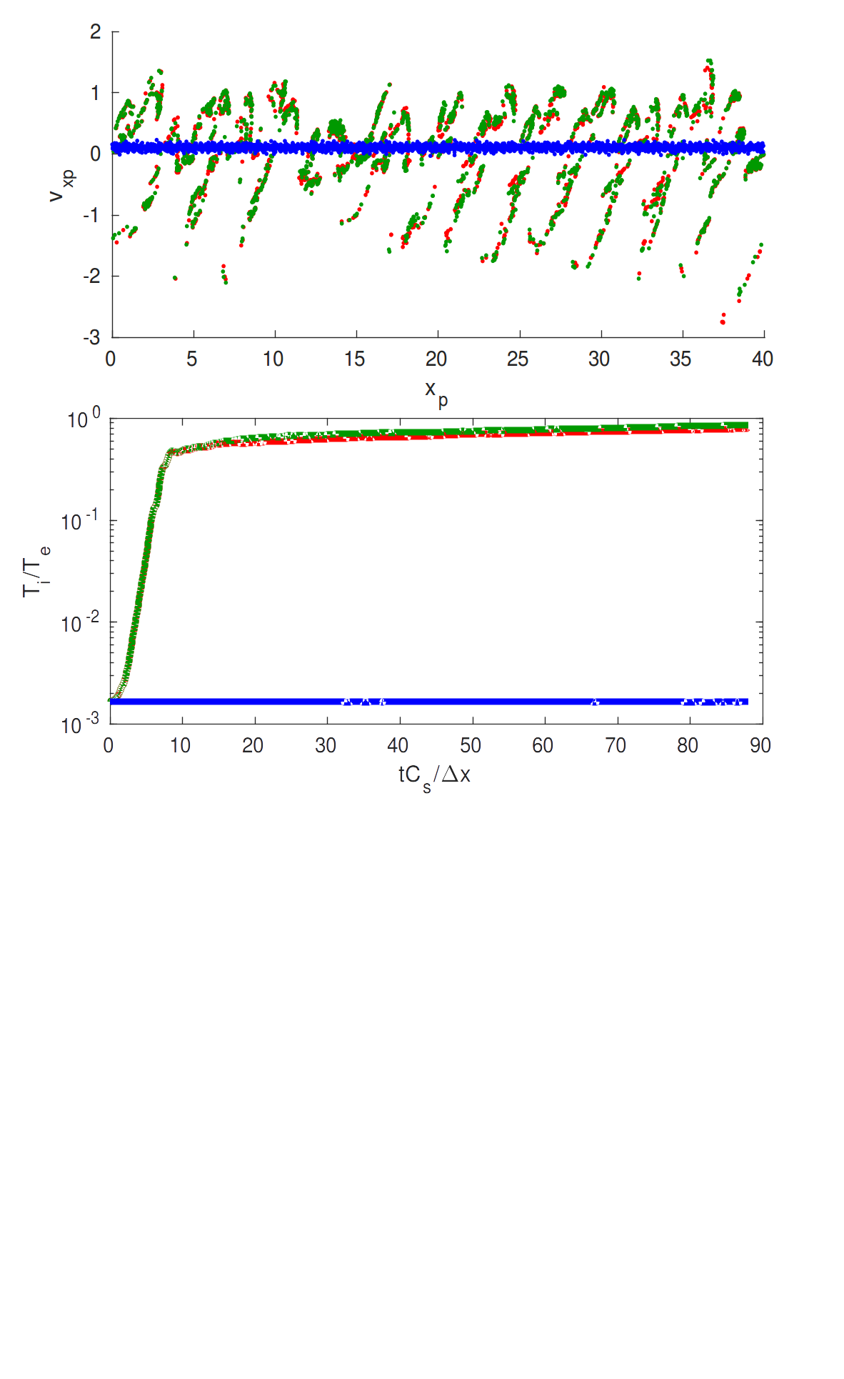
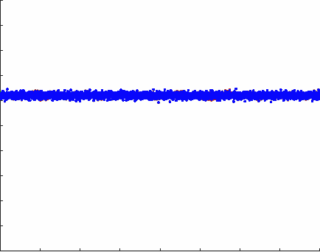
Finite Grid Instability (FGI) of cold ion beam
Nearest Grid Point, no smoothing, U₀/C_{s} = 0.1.
Cold ion beam moving through uniform spatial mesh.
Non-conservative (explicit) schemes unstable for T_{i}/T_{e} << 1 (Rambo, JCP 1995).
No unstable heating with implicit momentum+energy conserving algorithm.
Explicit one-pass method
Explicit predictor-corrector
Implicit momentum+energy conserving
Slide 29

Slide 30
Stochastic heating when FGI stable
For quadratic spline with smoothing, explicit becomes FGI stable for Ti/Te=0.01.
However, significant stochastic heating for explicit (Rambo, JCP 97).
Implicit scheme gives large improvement.
Slide 30

Slide 31
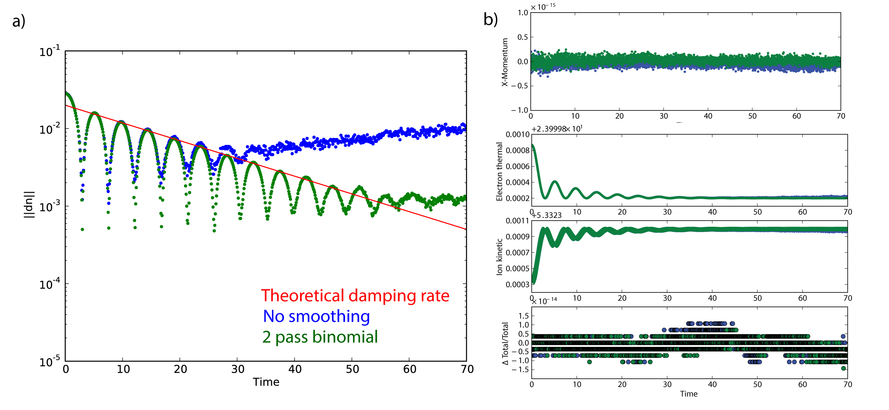
Verification: Landau Damped Ion Acoustic Wave
n = 1+0.01*sin(k_{x} x), k_{x}Δx = 0.065, 50000 particles/cell, quiet start.
Newton tolerance = 10⁻¹³.
10⁻¹⁵
2x10⁻¹⁴
Slide 31

Slide 32
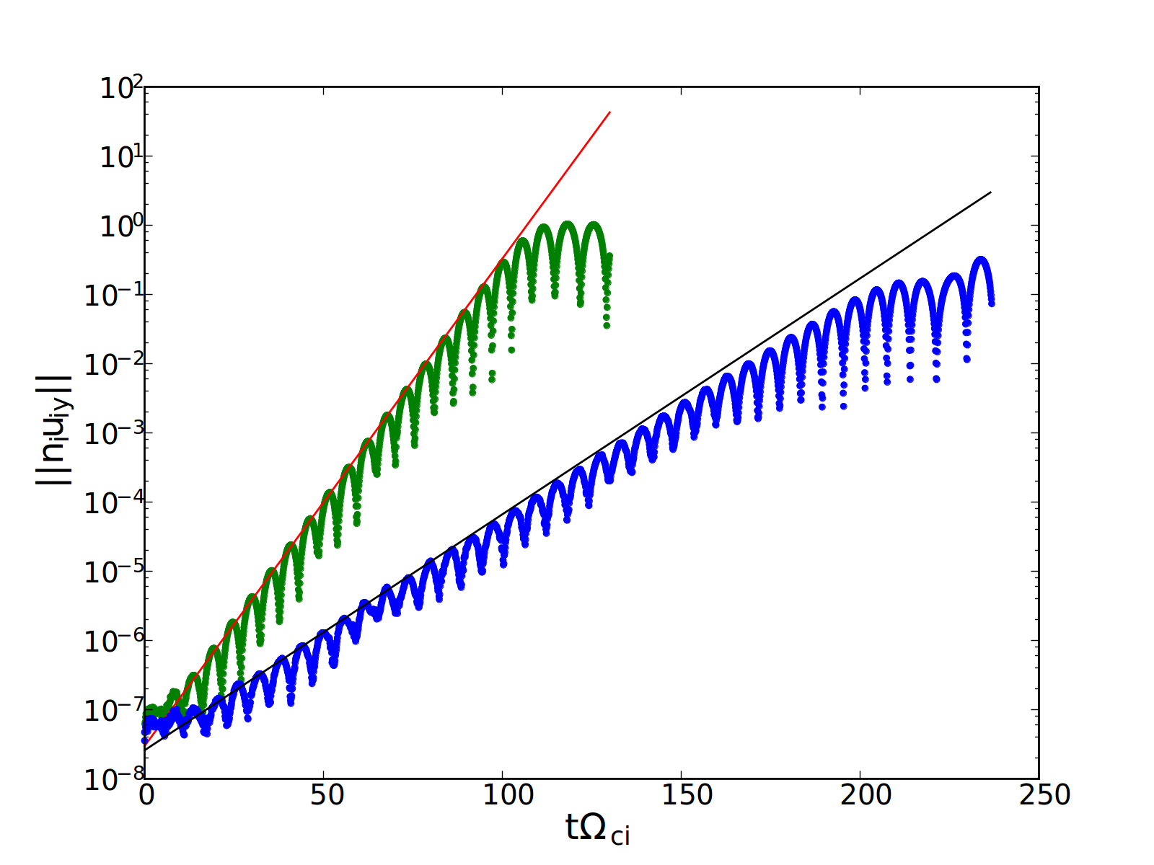
Verification: Proton Cyclotron Anisotropy Instability
Electromagnetic & multi-ion verification test:
  1D-3V electromagnetic instability driven by p_{i⟂}/p_{i//} > 1.
  Maximum growth at kxB=0, finite real frequency.
  k_{x}Δx = 0.065, 50000 particles/cell, 2x binomial smooth, quiet start.
  Newton tolerance = 10⁻¹².
  Momentum errors ~10⁻¹⁴.
  Energy errors ~10⁻¹².
Pure hydrogen plasma
20% α-particles
p_{α⟂}/p_{α//} = p_{p⟂}/p_{p//} = 3, β_{p//} = 1, T_{α//}/T_{p//} = 2, k//d_{p} = 0.6
Slide 32

Slide 33
Non-linear reconnection – GEM challenge
Current density/Flux
Include electron viscosity to set dissipation scale.
Reconnection rate = 0.25 (Birn, 2001).
  Newton relative tolerance = 10⁻¹⁰.
  Momentum errors ~10⁻¹¹.
  Energy errors ~10⁻¹⁰.
Large number of iterations (12 non-linear & 200 linear iterations) – need to implement preconditioner.
Slide 33

Slide 34
Stability against finite-grid (or aliasing) instabilities:
Numerical stability of cold ion beam
Hybrid algorithms susceptible to finite-grid instability for 0 < T_{i} << T_{e}, especially with finite drift.
  Linear theory formulated with continuous time + particle distribution (Rambo et al. JCP 118, 152-158, 1995).
  Even when linear theory is stable, finite particles + timestep can give stochastic heating (Full PIC: Abe et al, 1975, Hybrid: Rambo et al. JCP 133, 173-180, 1997).
We do not see unstable heating with implicit momentum & energy conserving algorithm, and stochastic heating is significantly reduced.
Explicit momentum conserving
Explicit momentum conserving
NGP, no smooth,
U₀/C_{s} = 0.1.
Unstable w.r.t. linear theory.
Quadratic+binomial smooth, U₀/C_{s} = 0.1
Implicit momentum+energy conserving
Implicit momentum+energy conserving

Slide 35
Verification: Landau-damped Ion Acoustic Wave
n = 1+0.01*sin(k_{x} x), k_{x}Δx = 0.065, 50000 particles/cell, quiet start.
Newton tolerance = 10⁻¹³.
Conservation properties
Theoretical damping rate
No smoothing
2 pass binomial
2 passes of binomial gives improved solution (reduced noise) with no impact on conservation.

Slide 36
Verification: Ion Cyclotron Anisotropy Instability
Electromagnetic verification test
1D-3V electromagnetic instability driven by p_{i⟂}/p_{i//} > 1
  Maximum growth at kxB=0, finite real frequency.
  k_{x}Δx = 0.065, 50000 particles/cell, 2x binomial smoothing, quasi-quiet start.
p_{i⟂}/p_{i//} = 3, β_{i//} = 1, k//d_{i} = 0.6
Theoretical growth rate
Simulation

Slide 37
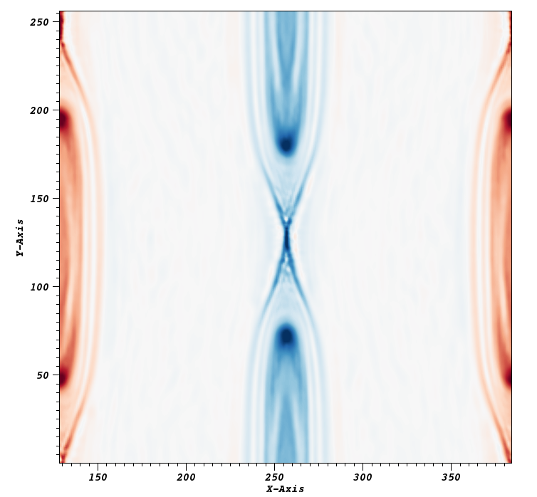
Verification: Magnetic Reconnection (GEM Challenge)
Non-linear problem with strong flows (reconnection outflow jets).
Discretize the conservative flux in (3) with SMART (Gaskell and Lau, 1988) for stable advection.
Reproduce (periodic) GEM challenge.
j_{z}

Slide 38
Fluid (XMHD) preconditioning (ongoing)

Slide 39
Preconditioning is key to performance
Iteration can be expensive:
  CPU time of PIC algorithms dominated by particle push.
  Particles pushed at every function evaluation (= GMRES + Newton).
Preconditioning:
  Can significantly reduce iteration count when P⁻¹ ≈ J⁻¹. Same converged solution.
  Cheap: only involves grid quantities.
Here, follow technique of physics-based preconditioning (e.g LC & Knoll JCP 2002, LC PoP 2008)
We use low-order (LO) fluid moments to accelerate the high-order (HO) kinetic ion model (“HOLO”).
e.g. Linearized density moment:
where

Slide 40
XMHD-based preconditioner (PIXIE3D)
Use ion fluid equations to predict density δn & velocity δu updates.
This is the well-known Hall MHD model, for which we have suitable preconditioning technology [LC, PoP (2008); JPCS (2008); JCP, in prep.]

Slide 41
XMHD-based preconditioner (cont.)
Linearized Jacobian:
Schur factorization gives three steps:
  (electron MHD prediction step)
  (ion velocity step. M⁻¹ ≈ Δt)
  (correction step)
Inversions are done with MG methods (optimal under mesh refinement)
2x2 block structure:

Slide 42
Preconditioner performance (preliminary)
MHD-scale right hand circularly polarized Alfven wave (λ = 64 d_{i}).
1D with n = 1, B_{x} = 1, v_{Ti} = 0.04, T_{e}=0. Δt = 1, 4 OMP/MPI.
Whistler CFL timestep (stiffest) Δt_{CFL} ~ n(Δx)²/B.
MPI | nx | CFL | Newt/dt (ident) | GMRES/dt (ident) | CPU (s) (ident) | Push/FE | ns/push
1 | 64 | 6.9 | (4) 4 | (6) 5 | (111) 105 | 30.6 | 92.6
2 | 128 | 26 | (6) 4.4 | (14.2) 7.4 | (199) 130 | 28.6 | 92.9
4 | 256 | 100 | (8.8) 4.6 | (106.4) 8.4 | (1916) 308 | 28.4 | 197.4
8 | 512 | 400 | (18) 5 | (446) 10.6 | (8029) 383 | 28.1 | 200.2
16 | 1024 | 1600 | 5.2 | 16.8 | 526 | 27.5 | 196
32 | 2048 | 6400 | 5.2 | 23.6 | 718 | 28.5 | 197
64 | 4096 | 26000 | 5.4 | 16.4 | 697 | 36.2 | 199
128 | 8192 | 100000 | 5.6 | 16.6 | 998 | 50.4 | 204
256 | 16384 | 400000 | 5.8 | 18 | 1874 | 80.4 | 222

Slide 43
Extension to curvilinear meshes

Slide 44
Extension to mapped curvilinear grids
Smooth, stationary map from logical to physical domains.
Logical mesh for grid quantities:
Modified version of the “hybrid” particle push to avoid fictitious forces:
Scatter/Gather Cartesian components to/from logical position:
Cartesian velocity:
Logical position:

Slide 45
Verification: 2D Alfven-Whistler on curvilinear grids
Cold RH Alfven Whistler an exact non-linear solution of hybrid model.
Set k d_{i} ~ 1 to test ion + electron components.
GIVE CONTINUUM DISPERSION RELATION HERE? WOULD BE GOOD INTRO FOR LATER..
Cartesian with 4x packing in x & y
Sinusoidal (non-orthogonal) mesh
Verification: 2D right-hand EM Whistler wave with kd_{i} = 0.3.
  Includes kinetic (particle) ion and EMHD (grid) contributions.
  Exact solution to the non-linear hybrid model – can test convergence.

Slide 46
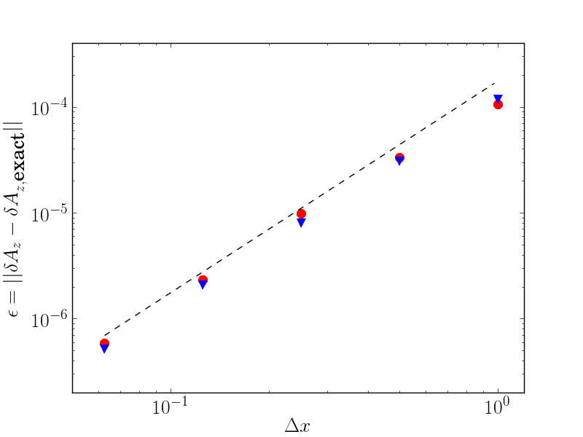
Verification: 2D Alfven-Whistler on curvilinear grids
Cartesian with 4x packing in x & y
Sinusoidal (non-orthogonal) mesh
Linear momentum conserved for Cartesian packed grids.
Energy conservation conserved for arbitrary curvilinear grids.
2nd order convergence to exact solution.
Slide 46

Slide 47
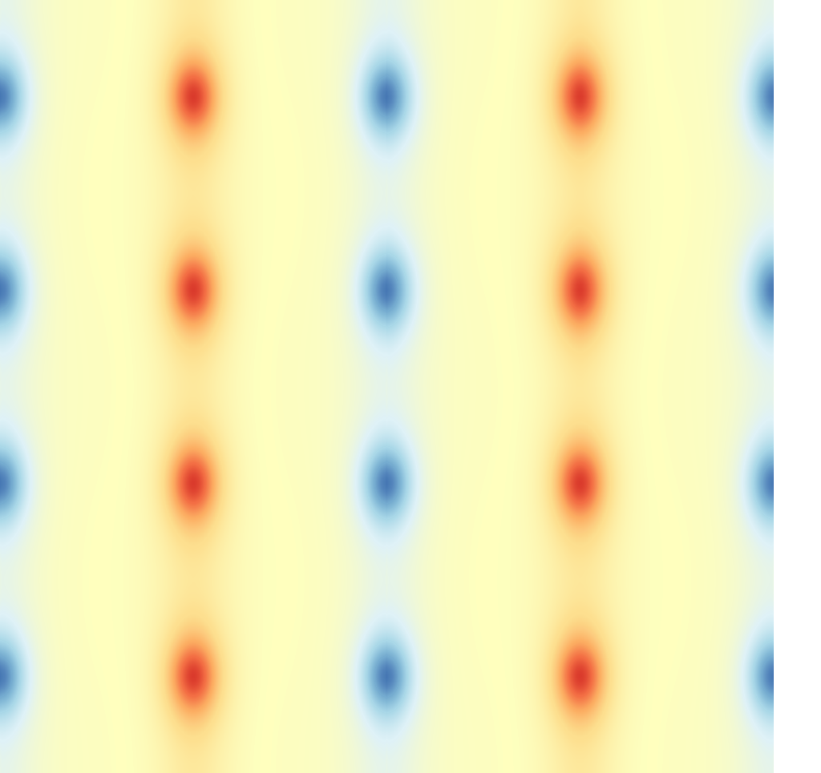
Verification: Island coalescence on packed mesh
Mass-matrix solve for particle weights to initialize exact moments at grid points.
512x512 uniform mesh
128x128 packed mesh
512x512 uniform mesh
512x512 uniform mesh

Slide 48
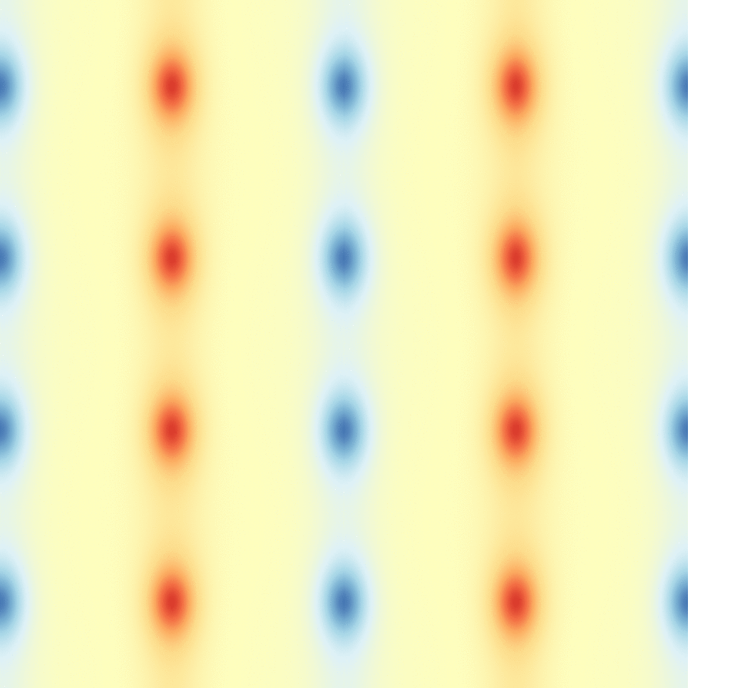
Verification: Island coalescence on packed mesh
512x512 uniform mesh
128x128 packed mesh
512x512 uniform mesh
512x512 uniform mesh

Slide 49
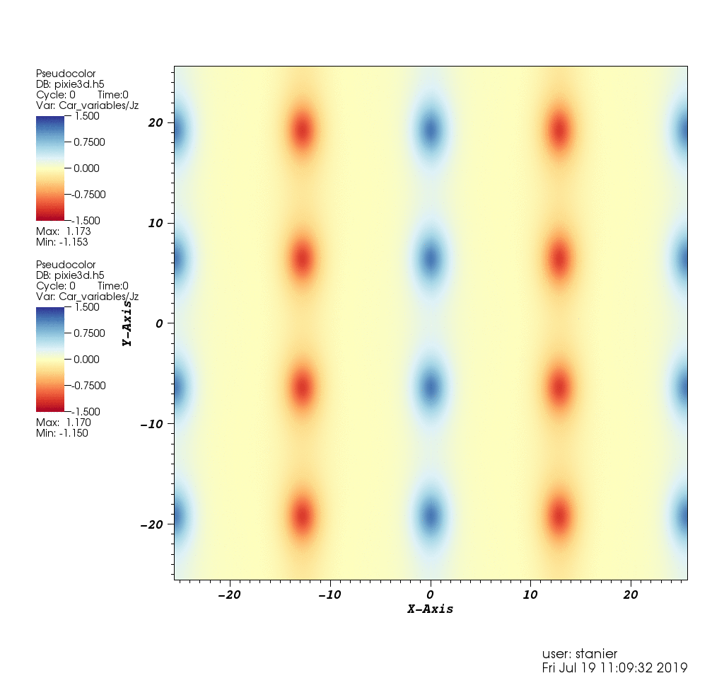
Application to nontrivial EM problem: Island Coalescence
Applied to island coalescence in doubly periodic geometry (exact conservation)
Run fully resolved Cartesian simulation, and compared against packed mesh run resolving reconnecting current layer
Mesh resolutions:
  Uniform: 512x512
  Packed: 128x128
Packing ratio: 4x

Slide 50
Asymptotic well-posedness of hybrid-PIC: a cancellation problem

Slide 51
Does hybrid-PIC preserve asymptotic MHD limit?
Cold ion and electron momentum equations:
Continuum limit with d_{i} → 0:
Does this cancellation work in the discrete?
  Focus on spatial discretization used in most PIC-hybrid schemes.
??

Slide 52
Consider polarized Alfven wave dispersion
Linearize semi-discrete equations and assume plane wave ansatz.
Ion momentum equation lives in continuum:
Faraday & Ohm’s law solved on spatial grid.
Electric field in continuum:
Ion velocity moment on grid:
where:
Sum over “aliases”,

Slide 53
The hybrid-PIC cancellation problem
RH Alfven-Whistler
LH Alfven-Cyclotron
k∆x = 𝝅/32
k∆x = 𝝅/32
Quasi-neutral hybrid only asymptotic preserving for nearest-grid-point (NGP) interpolation without smoothing!
In other cases: Need to resolve ion skin-depth – even in ideal MHD regions!

Slide 54
Numerical noise amplification by ∇P_{e} term
Electrostatic field E=-(∇P_{e})/en amplifies noise as gradient acting on noisy quantity.
Catastrophically, |Ex|₁ diverges (!) as O(Δx⁻¹) for fixed particles/cell (shown for IAW test).
  Needs special treatment to recover consistency
We have implemented filtering as P_{e} → (I-λ²∇²) P_{e}
  Recovers convergence, and can be done conservatively.
2nd order convergence O(Δx²) for cold EM whistler test.
Statistical errors due to finite # particles dominate for finite T_{i}.
EM whistler wave test (∇P_{e}=0)
ES ion acoustic wave test (∇Pe/=0)
Without Pe filtering
With Pe filtering

Slide 55
Conclusions and Future Work
We have demonstrated the first fully conservative hybrid PIC ions/fluid electrons algorithm.
Approach employs a collocated (unstaggered) spatial discretization.
Approach employs a multirate timestepping algorithm:
  Implicit mid-point in time for electrons, and subcycled (orbit-averaged) particle ions
Approach is able to employ conservative smoothing and pressure filtering to control numerical noise.
Algorithm has been shown to be remarkable stable against aliasing instabilities.
Has been extended to curvilinear geometry.
We have uncovered and characterized a hybrid-PIC cancellation issue, the solution of which requires either:
  Resolving ion skin depth (d_{i}) everywhere, expensive
  Lowest-order particle interpolation (NGP), noisy
Future research directions include:
  Finalize characterization of moment-based preconditioner.
  Extend conservation properties to realistic BCs (e.g., perfect conductor).
  Perform fusion-relevant simulations.

