Slide 1

Stability and nonlinear saturation of reconnecting current sheets in a helicity-conserving variational model
Joaquim Loizu
S. R. Hudson, Y.-M. Huang, Z. Qu, A. Kumar, A. M. Wright, R. L. Dewar
European Fusion Theory Conference, Ghent, Belgium, October 10th 2019

Slide 2
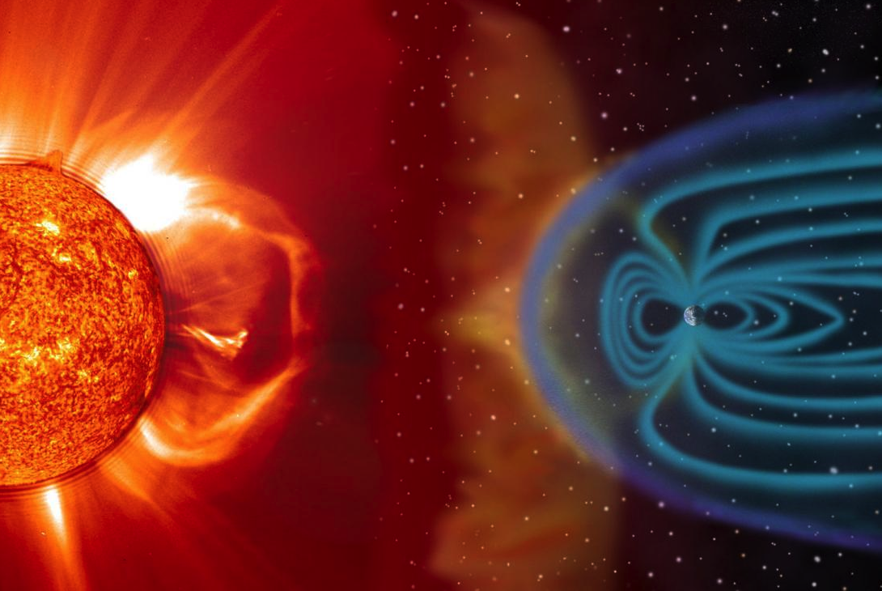
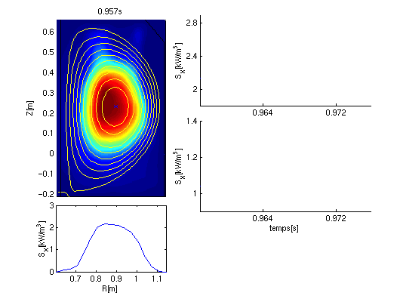
Magnetic reconnection is a ubiquitous phenomenon
Fast conversion of tremendous amounts of magnetic energy into kinetic energy is observed…
…in solar flares, as well as during the interaction
between the solar wind and the Earth magnetic field
…in magnetic fusion devices, for example
during sawtooth crashes in tokamaks

Slide 3
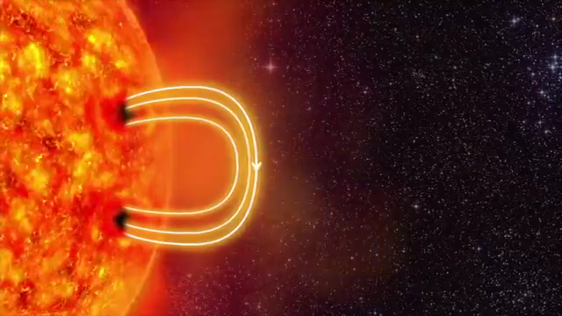
Magnetic reconnection breaks ideal MHD constraints
Opposite magnetic field lines, pushed
together by plasma flows, break and rejoin.
Only possible if the frozen-in-flux
condition (Alfven’s theorem) is broken.
Resistivity and localized currents
can produce reconnection.
Reconnection is usually many orders of
magnitude faster than resistive diffusion.

Slide 4
Tearing instabilities trigger fast reconnection
[Lütjens, JCP, 2008]
In the presence of a strong guide field (B_{𝜑} >> B_{𝜃} in tokamaks),
reconnection typically occurs via the tearing mode instability.
Tearing modes often develop as resistive MHD instabilities,
appearing when ∆’ > 0 (depends on the equilibrium profiles).
A magnetic island typically grows with time scales between
the ideal (Alfven) time 𝜏_{A} and resistive (diffusion) time 𝜏_{𝜂}.
In magnetic fusion, nonlinear saturation is observed, and the
island width w_{sat} is a critical parameter for machine operation.
Numerical simulations of this multiscale problem are expensive,
primarily because of large Lundquist number S = 𝜏_{𝜂} / 𝜏_{A} >> 1

Slide 5
Stability and saturation are independent of resistivity
OBS 1: linear theory of the tearing mode shows that
  ∆’ is independent of resistivity
  linear growth rate depends on resistivity,
OBS 2: nonlinear theory and simulations show that, for S >> 1,
  nonlinear growth rate weakly depends on resistivity
  saturation size of the island is independent of resistivity
OBS 3: saturation suggests the existence of another MHD equilibrium
linearly unstable, nonlinearly stable
Is there a variational principle allowing direct calculation of saturated tearing modes?

Slide 6
On the menu today
Magnetic helicity as a good invariant in reconnecting plasmas
Variational principle for partially reconnected plasmas
Numerical implementation in the SPEC code
Application to linear tearing stability of “textbook” tearing mode
Demonstration of nonlinear island saturation predictions in slab
Summary

Slide 7
Magnetic helicity is often a good invariant in MHD
[Berger, PPCF, 1999]
Magnetic helicity is defined as:
and is an integrated measure of the Gauss linking number for all pairs of field lines.
linking number = 1
linking number = 2
For an infinitely conductive fluid (ideal MHD), K is conserved in time:
using Faraday-Ohm’s law, B . n = 0 on the boundary, and a single-valued gauge for A.
For finite conductivity (resistive MHD), K is dissipated, but often much slower than energy
e.g. for small scale turbulence or for fast reconnection time scales.
[Taylor 1986 , Berger 1999]

Slide 8
There is experimental evidence for the invariance of K
[Ji et al, PRL, 1995]
[Heidbrink and Dang, PPCF, 2000]

Slide 9

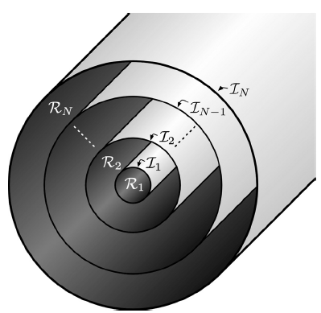
Equilibria can be obtained from a variational principle
minimize energy,
, with constraints on helicity,
more
constraints
Ideal MHD
K conserved
continuously
[Kruskal, Kulsrud, 1958]
N = ∞
MRxMHD
K conserved
discretely
[Dewar et al, 2006]
N = 1
N relaxation volumes
K conserved
globally
N-1 ideal interfaces
Taylor’s theory
[Taylor, 1974]
fewer
constraints
MRxMHD allows exploring energetically favorable reconnection events while constraining profiles.

Slide 10
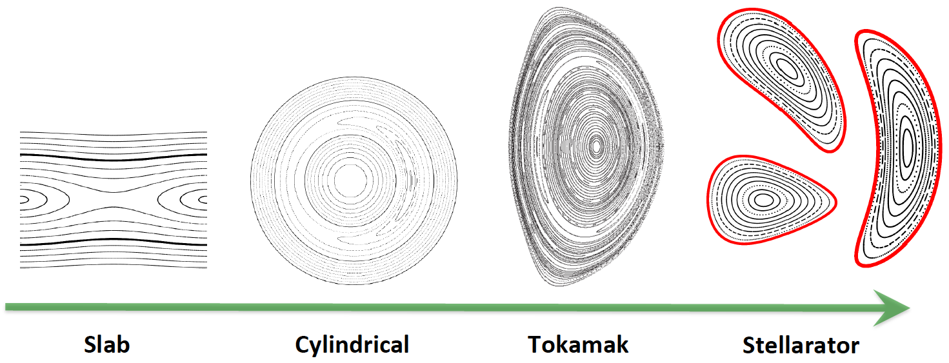
The SPEC code finds MRxMHD equilibria
Possible constraints
pressure, helicity, and fluxes
{ p , K , 𝚿_{pol} , 𝚿_{tor} }_{l=1…N}
pressure, current, and fluxes
{ p , 𝜇 , 𝚿_{pol} , 𝚿_{tor} }_{l=1…N}
pressure, iota, and flux
{ p , 𝛊⁺ , 𝛊⁻ , 𝚿_{tor} }_{l=1…N}
Input
Boundary geometry
+
Constraints
ι
ψ
Output
Shape of ideal interfaces
+
B in each volume
p
ψ
10

Slide 11
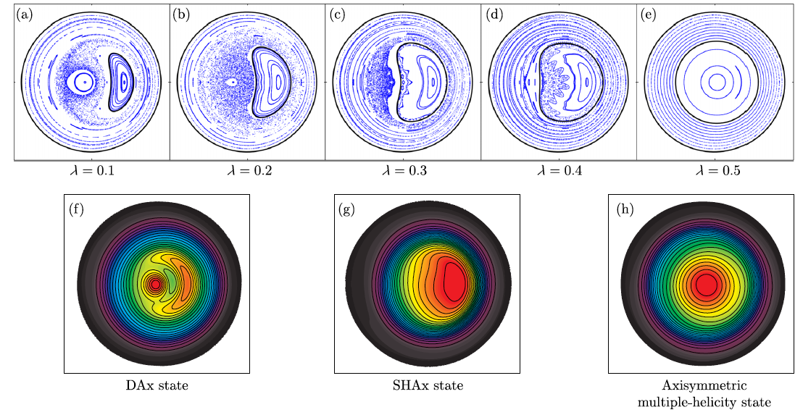
MRxMHD can describe equilibria with islands & chaos
EXAMPLE: Reversed Field Pinch configuration
Reproduced experimentally observed 3D states with SPEC and only N = 2.
[Dennis et al, PRL, 2013]
SPEC
soft X-ray
in RFX-mod

Slide 12
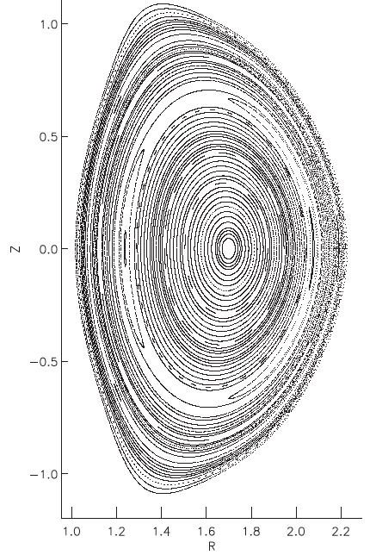
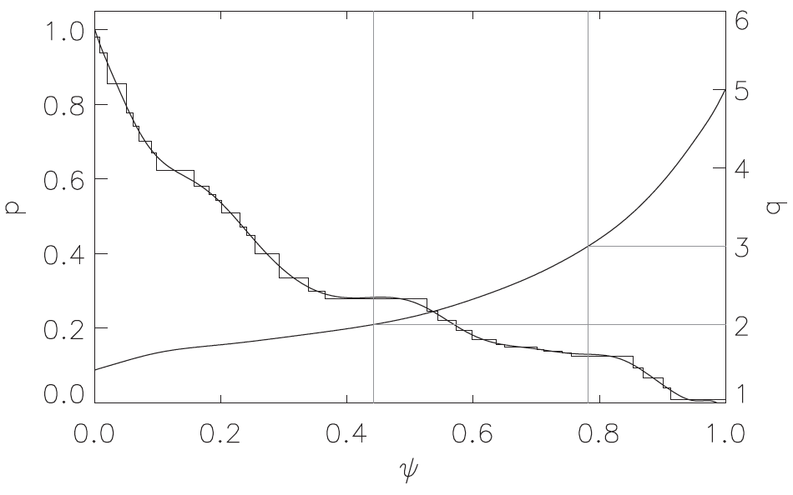
MRxMHD can describe equilibria with islands & chaos
EXAMPLE: Tokamak with resonant magnetic perturbations
Equilibrium reconstructed from DIII-D experimental profiles with N = 32.
[Hudson et al, PoP, 2012]
Magnetic island at
q = 2 rational surface

Slide 13
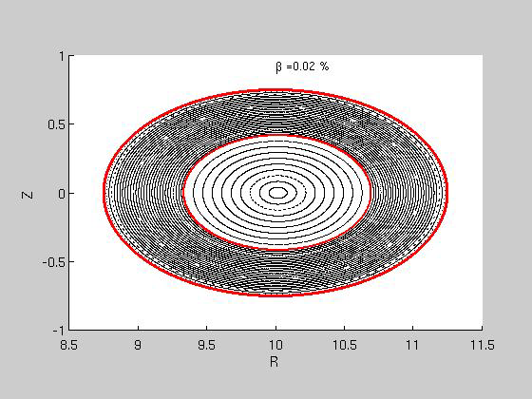

MRxMHD can describe equilibria with islands & chaos
EXAMPLE: Classical stellarator at fixed current or fixed iota
Equilibrium 𝛽-limits studied with SPEC and N = 2.
[Loizu et al, JPP, 2017]
ZERO CURRENT
FIXED IOTA

Slide 14
Stability obtained by exploiting a variational principle
Equilibrium states are those for which .
Their stability can be evaluated by studying the sign of for a finite perturbation.
degrees of
freedom
linearly stable
linearly unstable, nonlinearly stable
In the ideal limit, , MRxMHD stability analysis retrieves ideal stability.
For finite : retrieve instabilities developing via spontaneous magnetic reconnection.
Is tearing mode linear stability and nonlinear saturation described by MRxMHD?

Slide 15
A slab current sheet is ideally stable & tearing unstable
Consider a “textbook” force-free current sheet equilibrium:
B = B_{z} e_{z} + e_{z} ×∇𝜓(x) , with strong guide field, B_{z} >> B_{y} .
m = 1
x = 0 surface is resonant, , for all k = k_{y} .
ideally stable
[Goedbloed et al, PRA, 1971]
tearing unstable for
[Goldston et al, 1995]
in the limit of a strong guide field,
for the m = 1 tearing mode, k = 2𝜋 /L .

Slide 16
MRxMHD retrieves linear tearing stability threshold
Equilibrium described by MRxMHD with N = 3.
Perturbation of interfaces allows constructing Hessian “matrix of force derivatives”
Eigenvalues of H provide stability information, 𝜆 < 0 means instability
Here we can calculate analytically the eigenvalue 𝜆 for the m = 1 mode ,
[Loizu and Hudson, PoP, 2019]

Slide 17
A lower energy state with an island exists
Explored the space of W(x) where x is the amplitude of the m = 1 perturbation.
Energy valley is observed, suggesting the existence of a saturated island.
w_{sat}
x
x
y
y
Can we use a variational principle to predict w_{sat} without resolving the dynamics?
Can we validate predictions against resisitive MHD theory / simulations?

Slide 18
SPEC can be used for more general equilibria
Consider a slab equilibrium as in , B = B_{z} e_{z} + e_{z} ×∇𝜓(x) , with
[Loureiro, PRL, 2005]
Construct SPEC equilibrium with N >> 1.
Interfaces packed around resonant surface.
B_{y}
{ p , 𝜇 , 𝚿_{pol} , 𝚿_{tor} }_{i=1…N} extracted analytically.
Two control parameters: 𝚿_{w} and L
x
x
𝚿_{w}
j_{z}
L
x
y

Slide 19
SPEC retrieves linear tearing stability for 𝚿_{w} ⟶ 0
Linear tearing stability parameter is :
For the m = 1 tearing mode, k = 2𝜋 /L .
[Porcelli, PPCF, 2002]
x
𝚿_{w}
L
y
𝚿_{w} ⟶ 0

Slide 20
Analytical nonlinear theory exists in slab
Quasi-linear theory of the tearing mode was developed in 1977.
Exact nonlinear theory (POEM) was developed in 2004.
POEM has a universal character and
w_{sat} is independent of resistivity.
Both theories are only supposed to be
valid for sufficiently small ∆’ .
[White, PoF, 1977]
, where 𝛼 depends on current and resistivity profiles
[Escande and Ottaviani, PLA, 2004]
[Militello and Porcelli, PoP, 2005]
, where

Slide 21
Resistive MHD simulations provide w_{sat} at large ∆’
j_{z}
Solved the compressible, visco-resistive, MHD
equations in 2D
[Huang and Bhattacharjee, AJ, 2010]
with same initial equilibrium,
B = B_{z} e_{z} + e_{z} ×∇𝜓(x) , with

Slide 22
Quasi-linear argument used to find critical 𝚿_{w}
In SPEC, we scan ∆’ by scanning L. But which value shall we choose for 𝚿_{w} ?
x
x
𝚿_{w}
L
y
𝚿_{w} ⟶ 0
Recipe: for each L ,
find 𝜆(𝚿_{w}) = 0
run nonlinear SPEC

Slide 23
SPEC nonlinear calculations retrieve w_{sat} scaling
Nonlinear calculations at fixed helicity
produce reasonable yet different scaling.
In POEM, the magnetic helicity is not
exactly (although quite well) conserved.
What is constrained to be constant is
the flux-surface averaged current < j_{z} >_{𝜓} .
Nonlinear calculations at fixed current
reproduce well expected scaling!
Results do not depend on N.
A blue star takes ~ 1h and a red circle takes ~ 5 sec.

Slide 24
Summary and perpectives
The fundamental results presented here are:
MRxMHD can be used to predict linear resistive stability of force-free equilibria.
MRxMHD is able to obtain nonlinearly saturated tearing modes.
First demonstration that tearing mode saturation in strong guide fields can be directly obtained from a variational principle!
A direct implication is that numerical codes like SPEC, which calculate MRxMHD equilibria in toroidal geometry, can be used to (quickly) predict the resistive stability and tearing mode saturation in tokamaks and stellarators.
An open question is whether MRxMHD can also correctly calculate stability and saturation of tearing modes in the presence of pressure gradients.

Slide 25
Backup slides

